Slide 1
Mobile Price Range Prediction
Capstone Project
Team Members :-
Sidhartha Patel
Bhanu Prakash
Abdul Wadood
Ankit Patel
Anirudh Upadhyay
Mentor :-
Akash Dusane
1

Slide 2
INTRODUCTION
Mobile now a days is one of the most selling and purchasing device. Every day new mobiles with new version and more features are launched. In this competitive mobile phone market, companies want to understand the sales data of the mobile phones and factors that drive the prices.
The objective is to find out some relation between features of a mobile phone (eg :- RAM, Internal Memory etc) and its selling price.
Further, based on different features of the mobile phones, develop a model that would classify each mobile into different categories of price range i.e. into categorical values of 0(low), 1(moderate), 2(high), and 3(very high).

Slide 3
DATA SUMMARY
We have in total of 21 features (20 independent and one dependent) and 2000 observations.
Our Dependent feature which we have to predict i.e. price range has multiclass categorical value 0,1,2 and 3.
Overall the data is perfectly balanced (500 observations for each class) with minimal number of missing values.
There is little to no correlation between our independent features, otherwise it was handled.

Slide 4
Columns Description
battery_power :- total energy a battery can store in one time measured in mAh
int_memory - internal memory in Gigabytes
blue:- has bluetooth or not (0,1)
clock_speed :- speed at which microprocessor executes instructions.
fc:- front camera Mega Pixel
four_g - has 4G or not(0,1)
dual_sim:- has dual sim support or not (0,1)

Slide 5
…
m_dep - mobile depth in cm
mobile_wt - weight of mobile phone
n_cores - number of cores of processor
pc - primary camera mega pixels
px_height - pixel resolution height
px_width - pixel resolution width
ram - random access memory in Mega Bytes

Slide 6
…
sc_h - screen height of mobile in cm
sc_w - screen width of mobile in cm
talk_time - longest time that a single battery charge will last when you are
three_g - has 3G or not
touch_screen - has touch screen or not
wifi - has wifi or not
price_range - this is the target variable with value of 0(low cost), 1(medium cost), 2(high cost) and 3(very high cost)

Slide 7
Preliminary EDA
And
Data Preprocessing

Slide 8
We have renamed columns to suitable & understandable names.
old_name | new_name
‘blue’ | ‘bluetooth’
‘fc’ | ‘front_cam’
‘four_g’ | ‘4G’
‘int_memory’ | ‘ROM’
‘m_dep’ | ‘depth’
‘mobile_wt’ | ‘weight’
‘n_cores’ | ‘cores’
old_name | new_name
‘pc’ | ‘rear_cam’
‘px_height’ | ‘resol_height’
‘px_width’ | ‘resol_width’
‘ram’ | ‘RAM’
‘sc_h’ | ‘height’
‘sc_w’ | ‘width’
‘three_g’ | ‘3G’

Slide 9
Divided the Features into categorical and continuous values for better understanding of the data.
Categorical Variables
dual_sim
wifi
3G
cores
4G
bluetooth
Touchscreen
Continuous variables
Resolution
Rear_cam, front_cam
Dimension
RAM, ROM
Clock_speed
Weight
Battery_power

Slide 10
The column ‘resol_Height’ had two null values, so both the observations were dropped.
Also the column ‘width’ had 180 rows labelled as zero.
These 180 values were imputed through KNNImputer(n=1) method from the sklearn.impute module
Using statsmodel library, we calculated variance inflation factor for all features and dropped weight column because it had high value.
screen_height & screen_width columns was clubbed together as length of the phones.
Similarly, px_height & px_width columns were clubbed into one feature as resolution.
Final data prepared had 18 columns and 1998 number of rows.

Slide 11
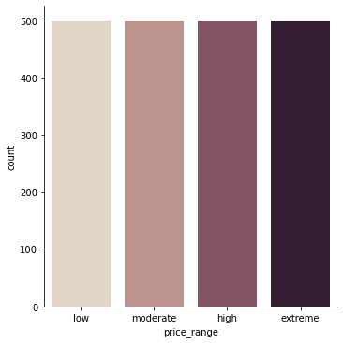
Graph of No. of Observations for each Price range.
The data is equally divided into all the four class for price range i.e there is no class imbalance

Slide 12
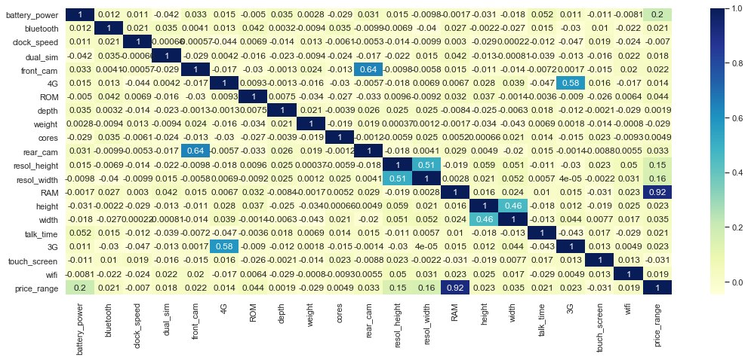
Correlation Heat Map.

Slide 13
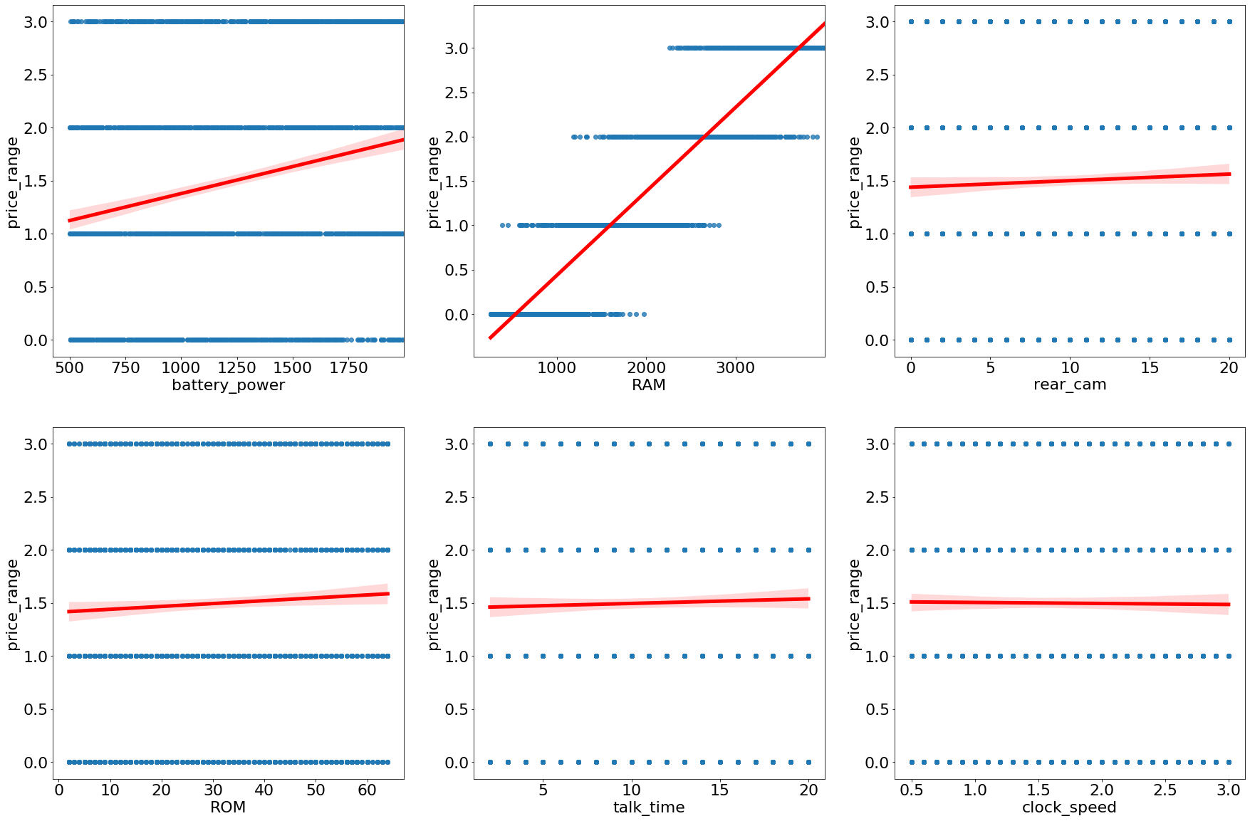

Slide 14
On plotting Regression Plots of all the continuous independent feature with our dependent feature (for class 0, 1, 2, 3),
We could see that that RAM of mobile is very highly correlated with the price range associated with the mobile
Also Battery_power shows similar trend but not to that extend
Others continuous features showed little to no collinearity with our dependent feature i.e Price range

Slide 15
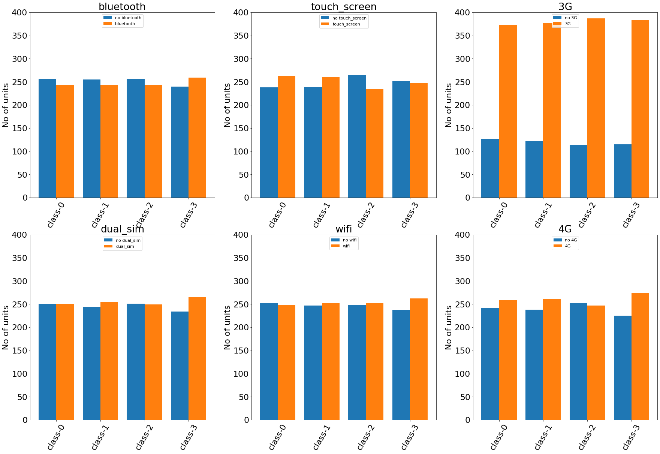

Slide 16
On plotting Bar Plots of all the Categorical independent feature with our dependent feature against all class
We can observe that number of the mobile phones with 3G is more than phones that don’t have 3G.
Also, we can see that there is no imbalance of phones having or not having 3G with the price range associated with the mobile phones i.e the observations having 3G is equally distributed across all class and observations not having 3G is also distributed equally across all class.
For all other features the number of observation is equal across all class and also within the feature itself.

Slide 17
Model Implementation

Slide 18
Since our problem was of classifying mobile phones into four different class based on its features, we implemented classification algorithms using the sklearn library
KNN
Logistic Regression
Decision Trees
Random Forest
AdaBoost
GradientBoost
XGBoost

Slide 19
Splitting :- Dividing the data set onto X(independent) and Y(dependent) variable and splitting it into train and test using sklearn’s train_test_split function
Scaling :- Also, Feature scaling was done on the data using MinMaxScaler & Standard Scaler function in order to implement KNN and Logistic Regression
Hyperparameter Tuning :- Every algorithm was implemented using the default parameter settings from sklearn library.
Also using the BayesSearchCV func, for each algo, the best parameters settings was calculated based on the accuracy of the model.

Slide 20
EVALUATION

Slide 21
Evaluation Metrics
Accuracy
Precision
Recall
F1 Score
AUC RUC Curves
Since, this was a multiclass classification problem with very well balanced data, we used accuracy and F1 score which generally caters to better evaluation insights in classification problems.
Also, AUC-ROC curves for all class were plotted using one vs rest technique i.e class 0 vs class 1,2 & 3 combined and so on.

Slide 22
Before Tuning
Train Data
Test Data
Test Data
 | Accuracy | Precision | Recall | AUC_ ROC | Accuracy | Precision | Recall | AUC_ROC
KNN | 67.9 | 0.685 | 0.679 | 0.869 | 59.00% | 0.614 | 0.590 | 0.837
Decision Tree | 100.0% | 1.000 | 1.000 | 1.000 | 85.5% | 0.855 | 0.855 | 0.903
Logistic Regression | 92.68% | 0.927 | 0.927 | 0.992 | 89.25% | 0.892 | 0.892 | 0.990
Random Forest | 100.0% | 1.000 | 1.000 | 1.000 | 87.5% | 0.875 | 0.875 | 0.982
AdaBoost | 100.0% | 1.000 | 1.000 | 1.000 | 90.25% | 0.902 | 0.902 | 0.987
Gradient Boost | 99.69% | 0.997 | 0.997 | 1.000 | 89.5% | 0.895 | 0.895 | 0.988
XGBoost | 100.0% | 1.000 | 1.000 | 1.000 | 92.0% | 0.920 | 0.920 | 0.992

Slide 23
After Tuning
Train Data
Test Data
 | Accuracy | Precision | Recall | AUC_ ROC | Accuracy | Precision | Recall | AUC_ROC
KNN | 66.5% | 0.668 | 0.665 | 0.868 | 61.75% | 0.637 | 0.618 | 0.838
Decision Tree | 95.56% | 0.956 | 0.956 | 0.998 | 87.25% | 0.872 | 0.872 | 0.948
Logistic Regression | 94.99% | 0.950 | 0.950 | 0.997 | 93.0% | 0.930 | 0.930 | 0.996
Random Forest | 100.0% | 1.000 | 1.000 | 1.000 | 88.75% | 0.888 | 0.888 | 0.986
AdaBoost | 100.0% | 1.000 | 1.000 | 1.000 | 90.5% | 0.905 | 0.905 | 0.991
Gradient Boost | 100.0% | 1.000 | 1.000 | 1.000 | 90.5% | 0.905 | 0.905 | 0.991
XGBoost | 94.43% | 0.944 | 0.944 | 0.997 | 93.25% | 0.932 | 0.932 | 0.996

Slide 24
F1 score
 | Class-0 | Class-1 | Class-2 | Class-3 | Overall
KNN | 0.74 | 0.49 | 0.51 | 0.73 | 0.622666
Decision Tree | 0.92 | 0.82 | 0.84 | 0.91 | 0.872959
Logistic Regression | 0.96 | 0.92 | 0.91 | 0.93 | 0.930094
Random Forest | 0.94 | 0.83 | 0.82 | 0.90 | 0.874724
AdaBoost | 0.96 | 0.92 | 0.89 | 0.92 | 0.919715
Gradient Boost | 0.95 | 0.88 | 0.88 | 0.91 | 0.905377
XGBoost | 0.96 | 0.93 | 0.92 | 0.94 | 0.940114
The F1 score for class 1 and class 2 is low as when compared to class 0 and class 3 across all algorithms.
Overall F1 score for Logistic Regression and XGBoost algo faired better than others and KNN was the worst performing among all.

Slide 25
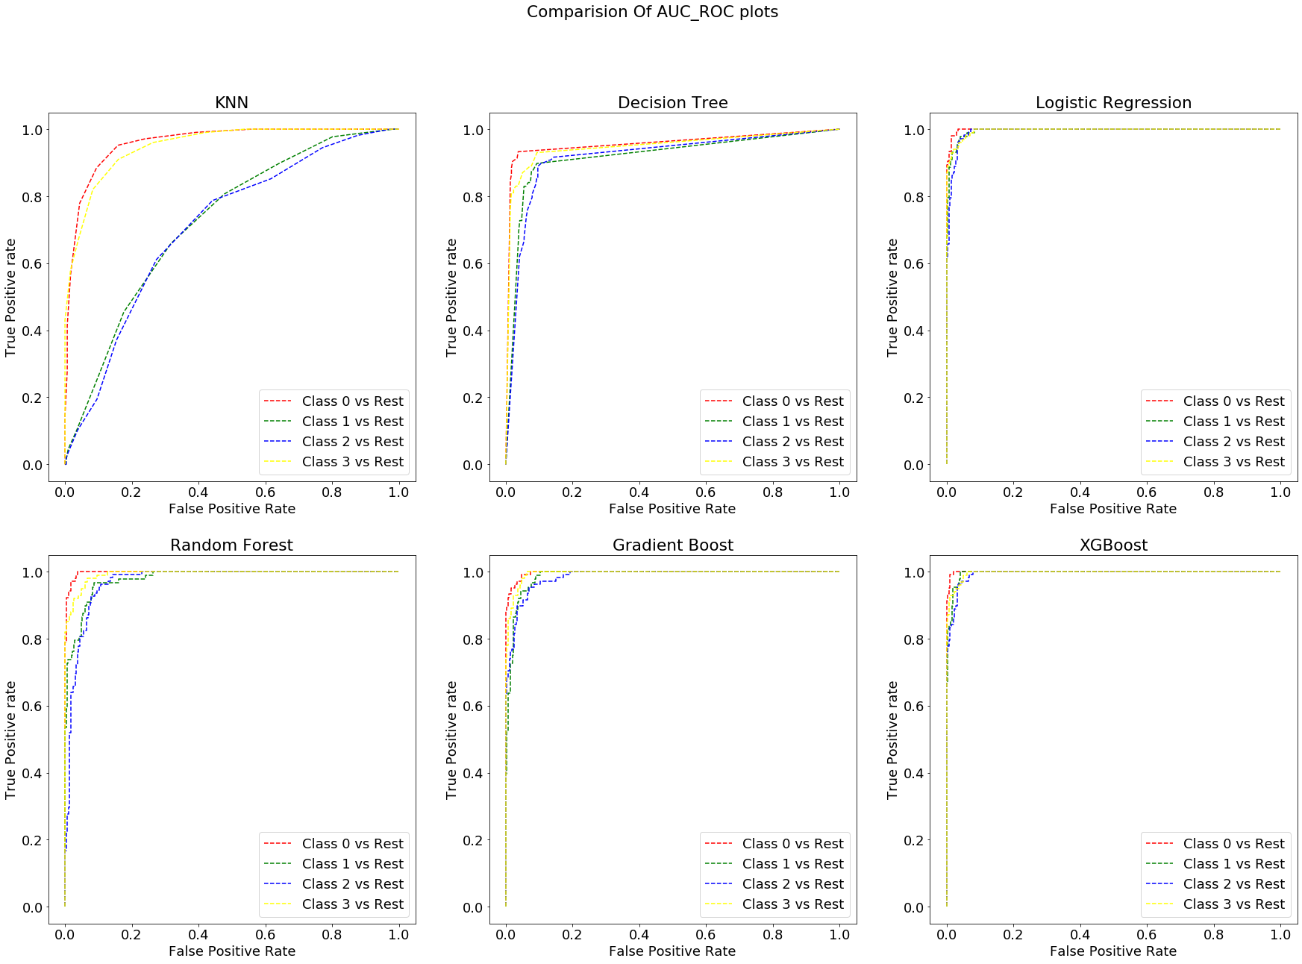

Slide 26
Conclusion
As this was a multiclass classification problem and the data set was very well balanced across all output class, Accuracy was a good parameter to evaluate our models.
In addition to Accuracy, we also calculated F1 scores across each output class to get overall picture.
Based on the evaluation metrics(Accuracy, Precision, Recall, F1 score)of the train and test data, we can conclude that Logistic Regression and XGBoost performed well among all models whereas KNN performed worst.
XGBoost is our goto model since it performed well and it is non parametric in nature for final model selection.
So we completed our exhaustive study to develop a model for mobile price ranges based on its features, and this model can help us in doing market research, competitive price estimates, and mobile phone’s Price vs Features comparisons.

